Slide 1
ADF Pipeline (Orchestrate 2)
On Prem MySQL (Multiple tables) → ADF → Azure SQL Database
Sink Multiple table through single Pipeline
Interview = How to migrate all tables from onprem to cloud?

Slide 2
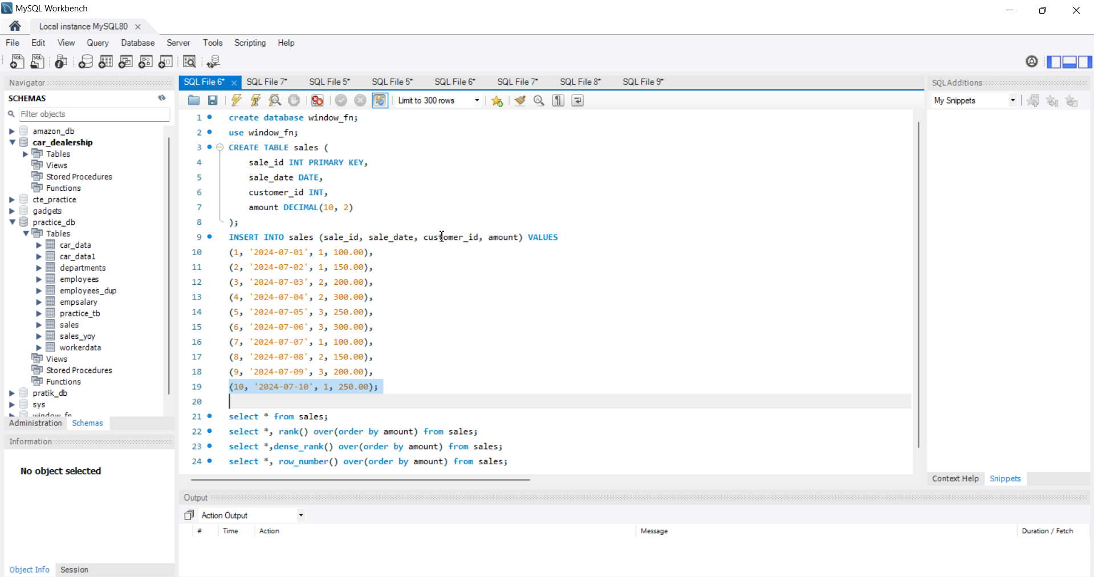
Create ADF, Azure SQL database and MySQL database OnPrem

Slide 3
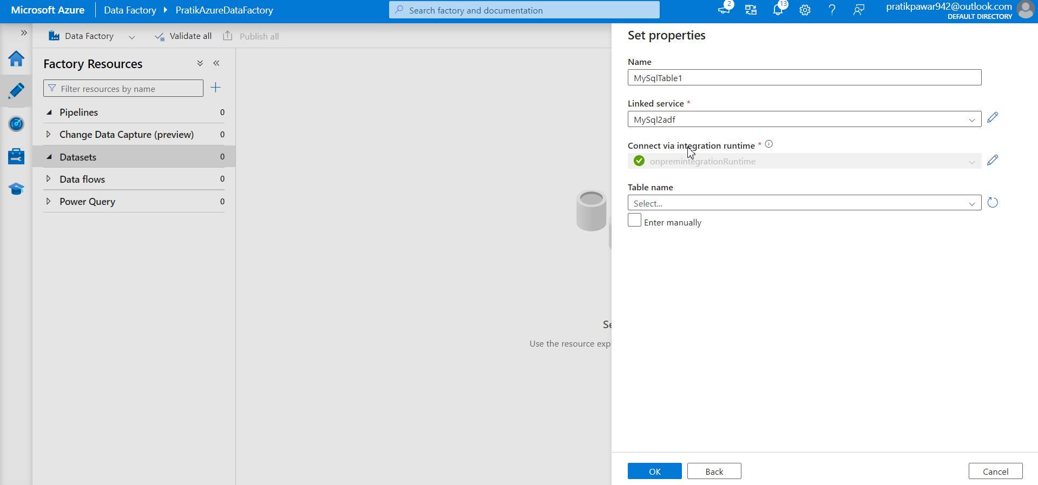
Linked through MsIntegrationRuntime to ADF

Slide 4
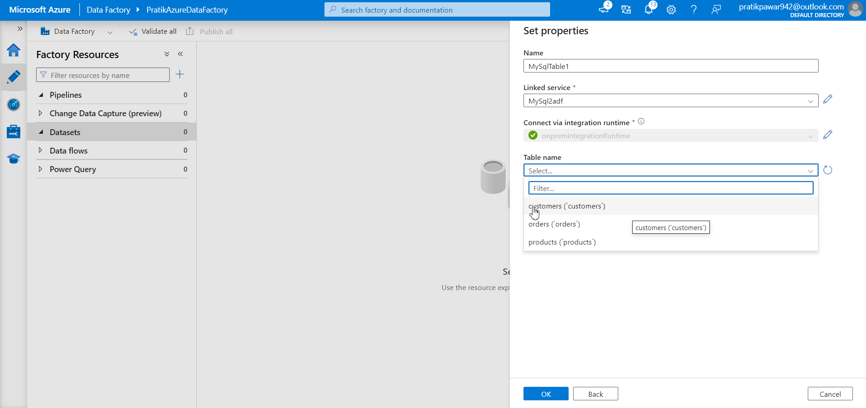
Select table

Slide 5
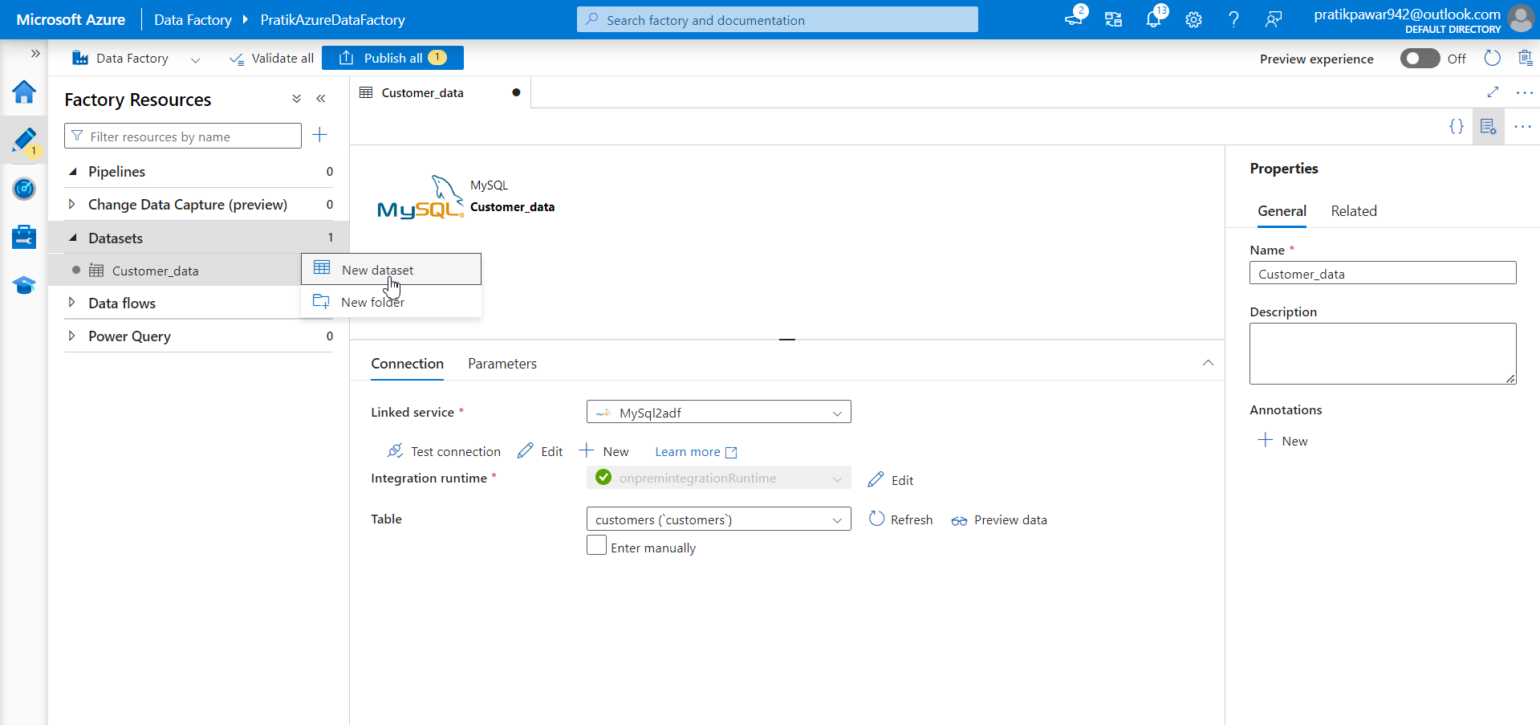
Again create new dataset and import other data through linked service

Slide 6
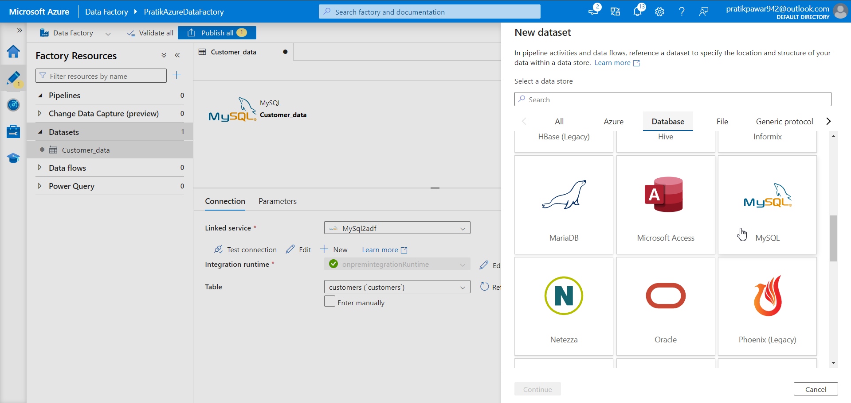
Mysql

Slide 7
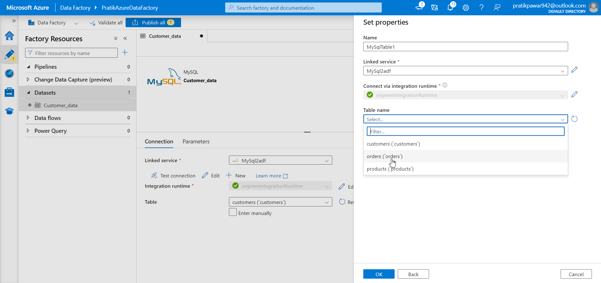
Select table

Slide 8
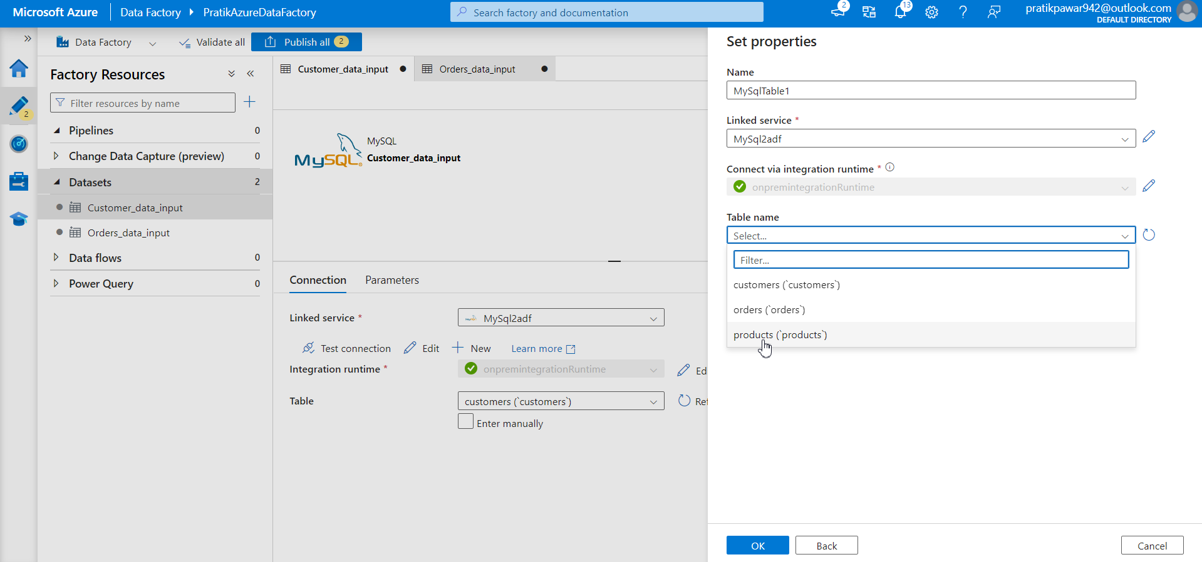
Same way import other tables

Slide 9
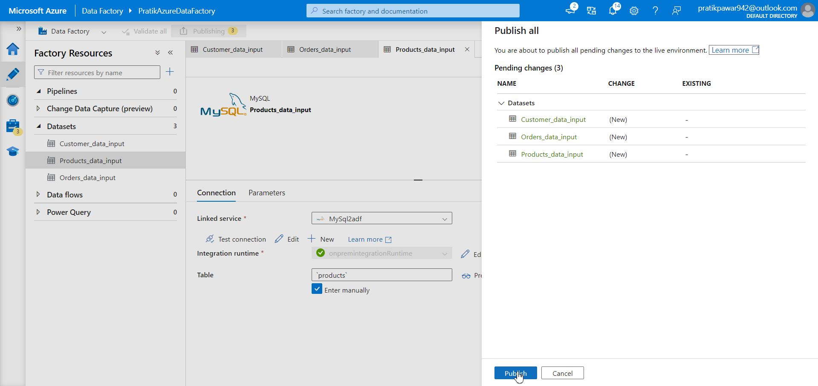
Publish

Slide 10
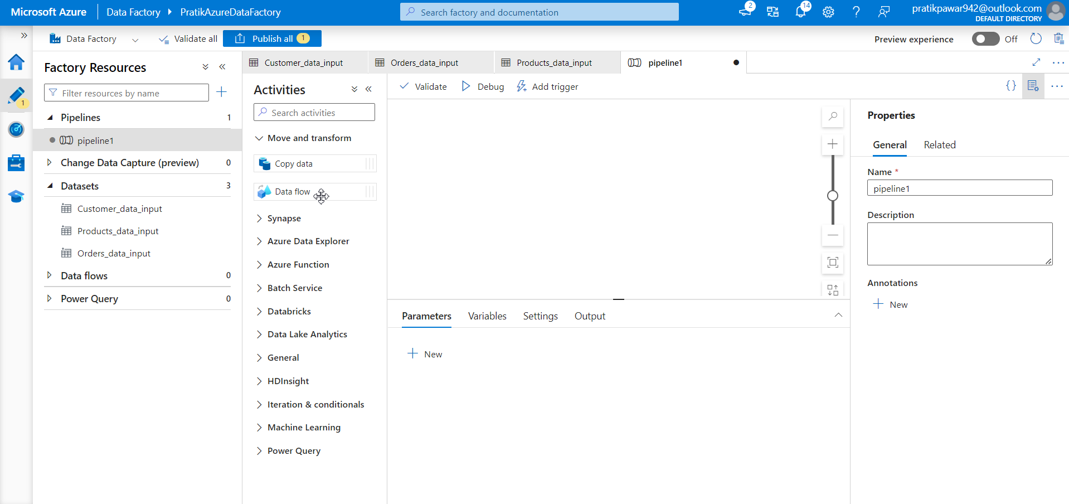
Create new pipeline

Slide 11
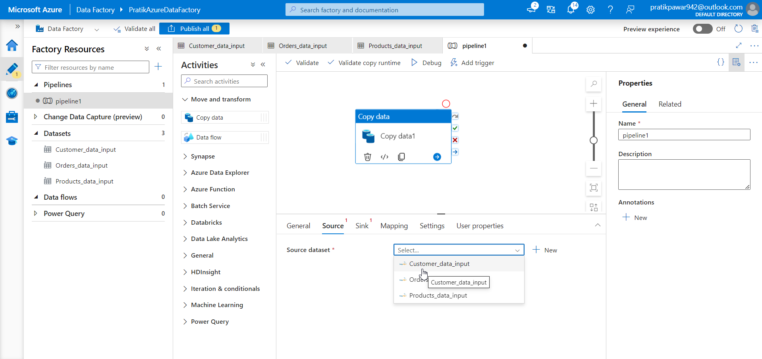
Select source

Slide 12
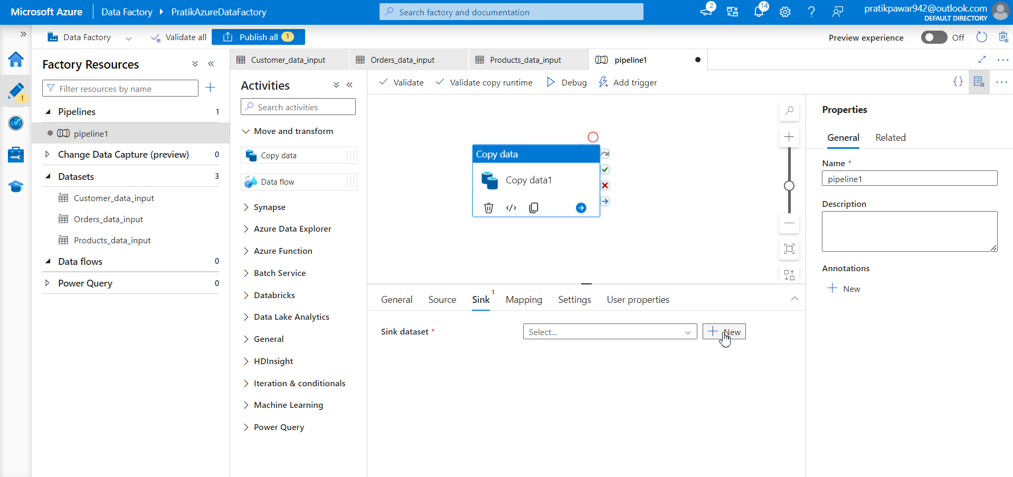
Sink Dataset > create new

Slide 13
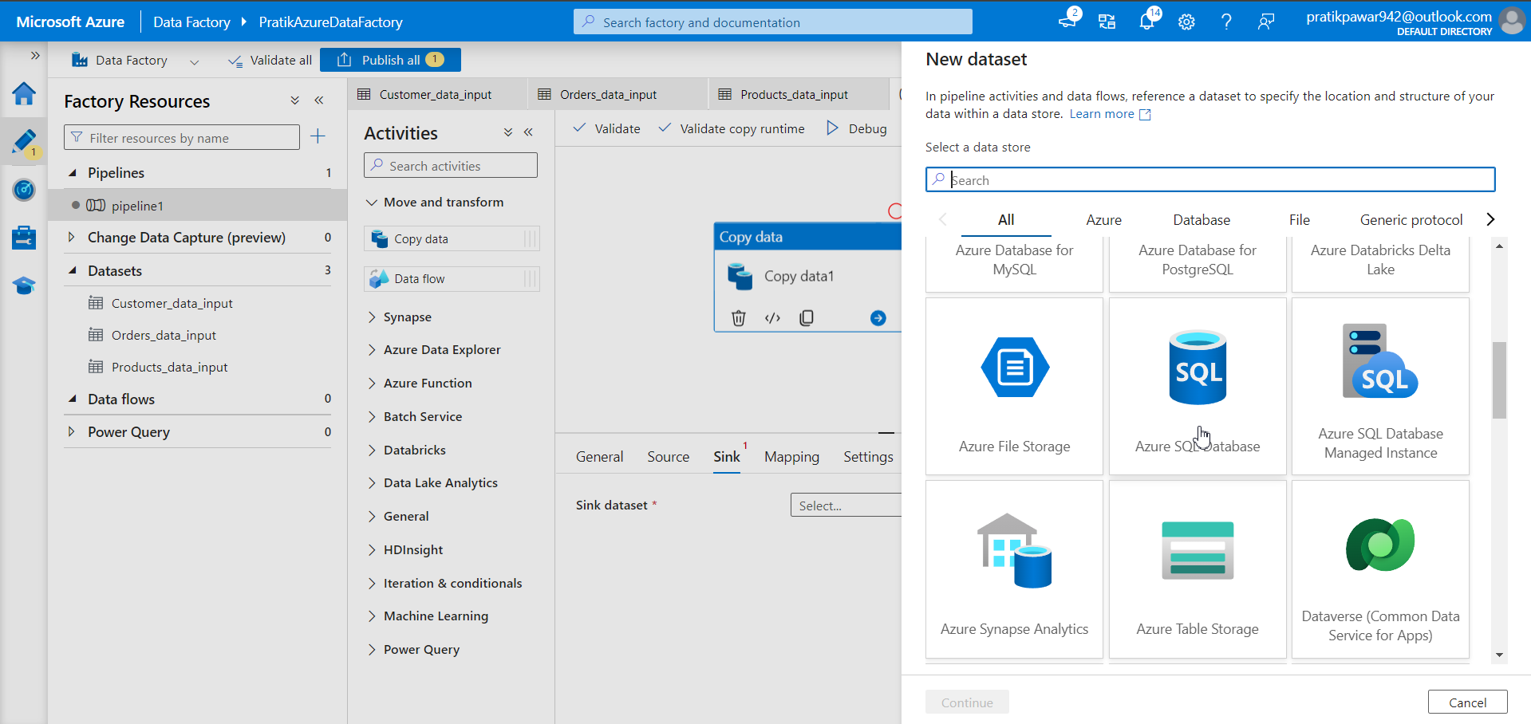
Azure SQL Database

Slide 14
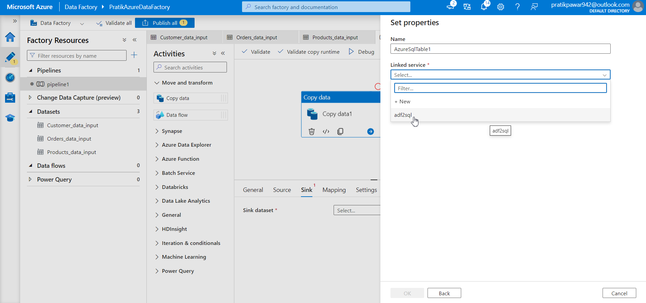
Create new linked service and select it

Slide 15
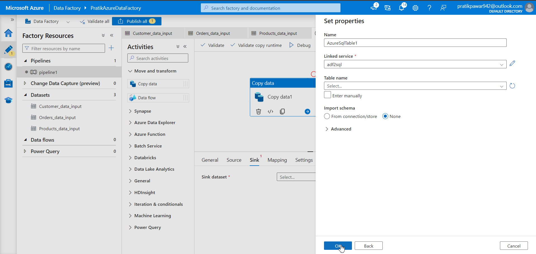
Click ok

Slide 16
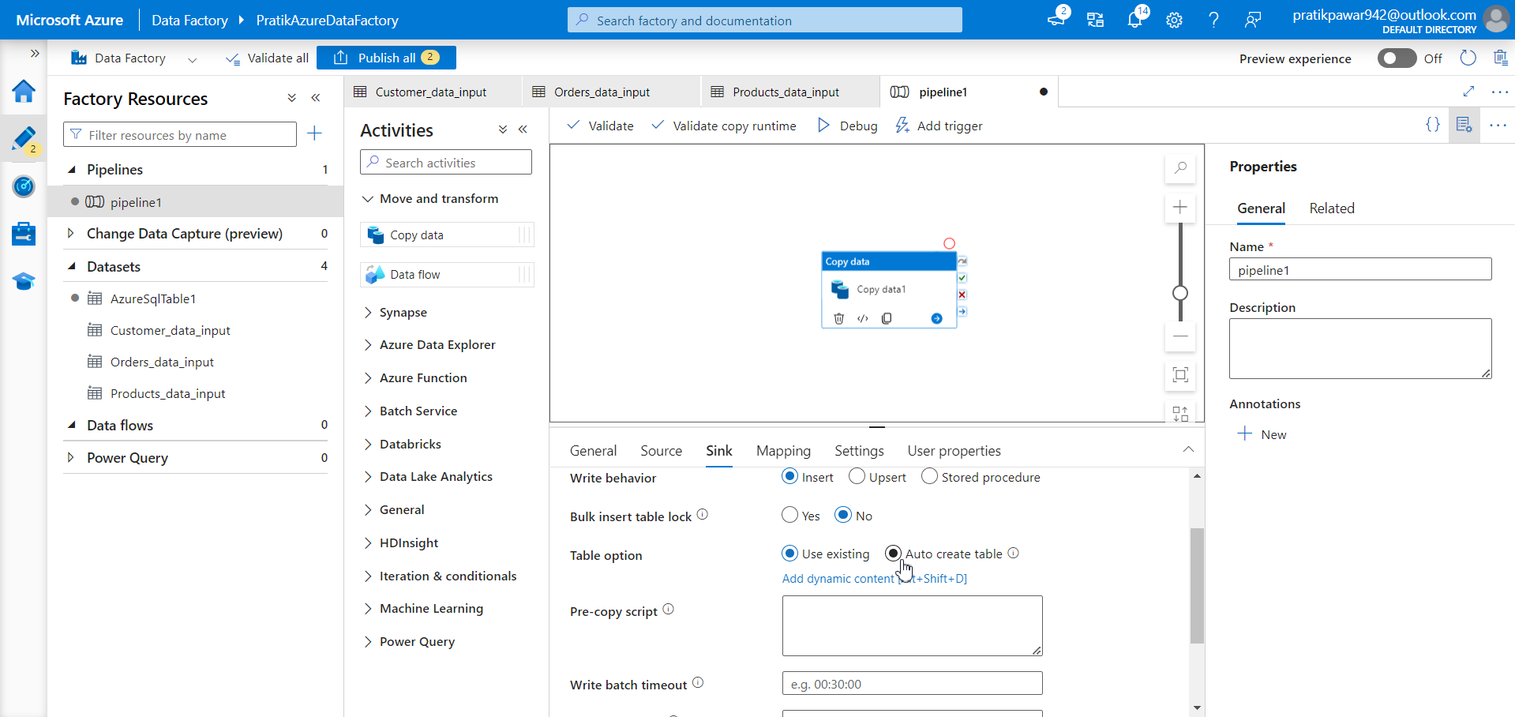
Auto create table

Slide 17
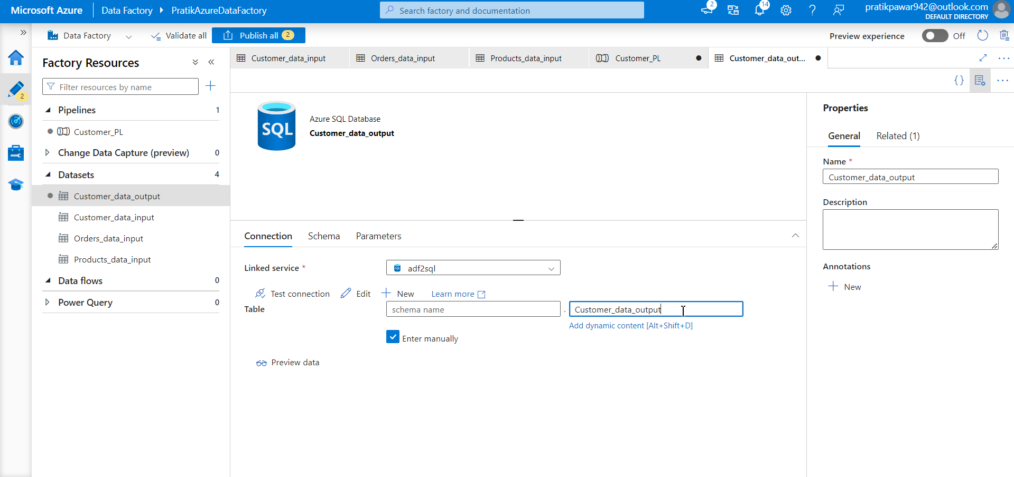
Write the table new which we want after the pipeline

Slide 18
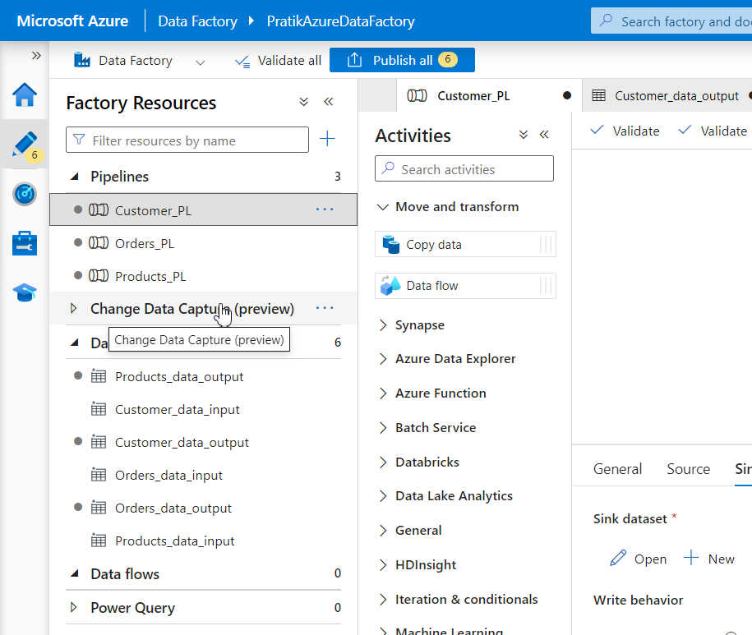
Repeat the process and make other pipelines and output datasets

Slide 19
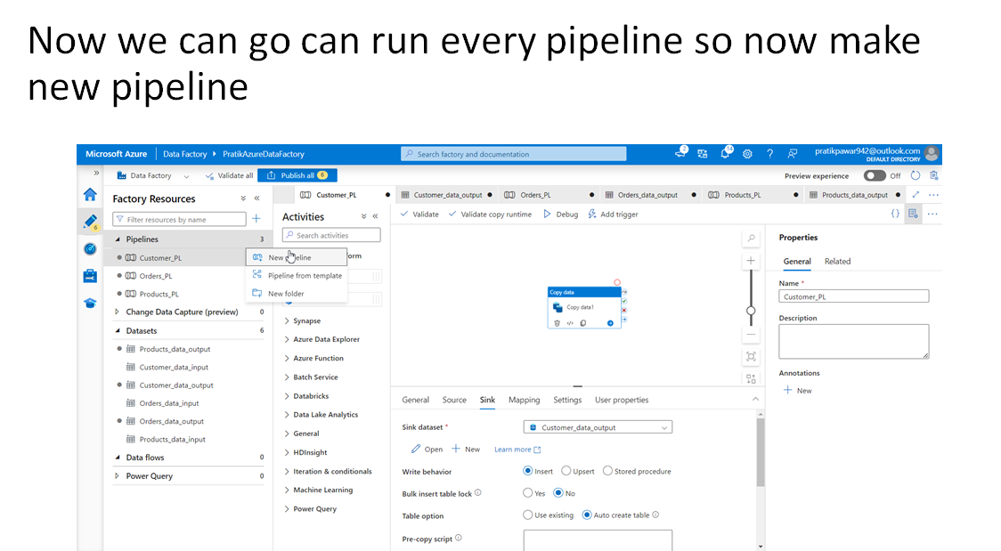

Slide 20
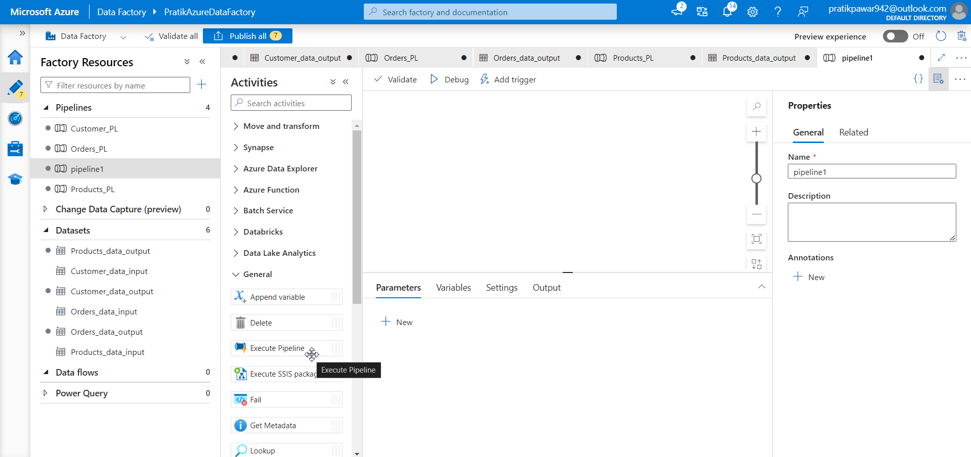
Go to General > Execute Pipeline (Migration Pipeline)

Slide 21
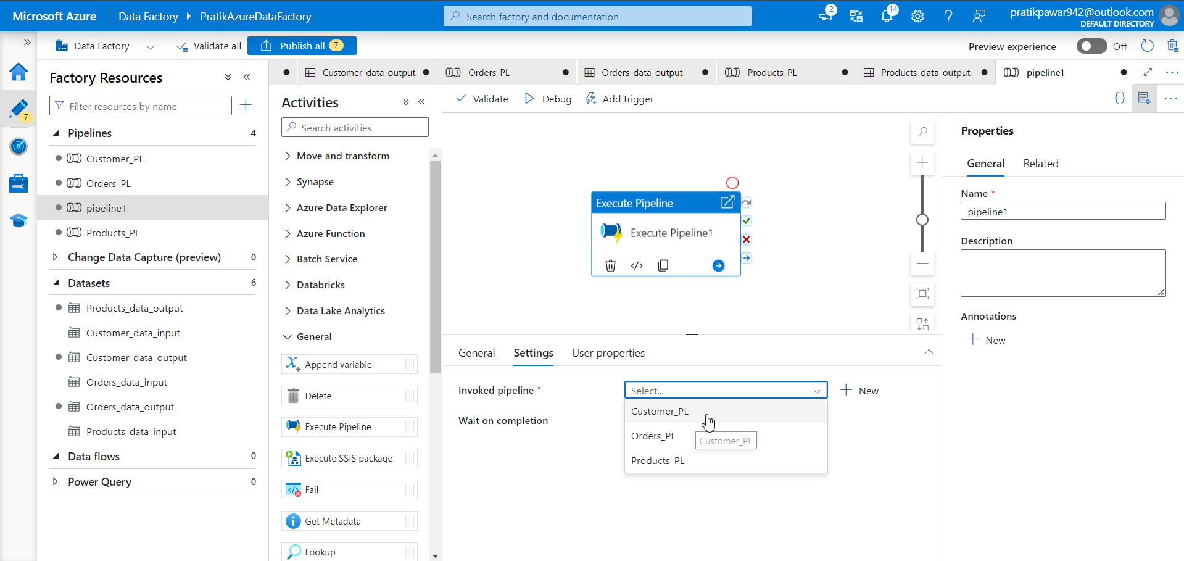
Go to Settings > add pipeline

Slide 22
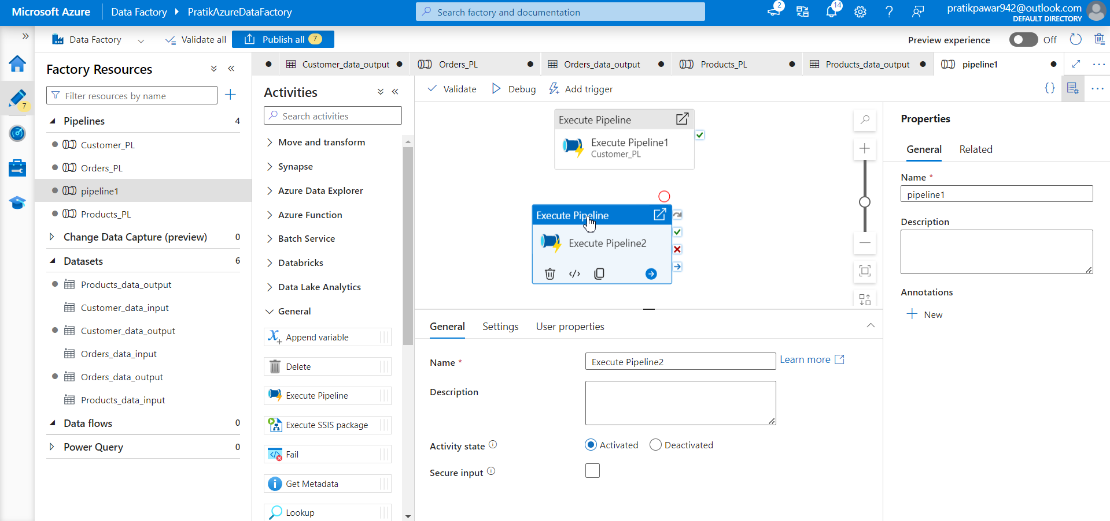
Now again take execute pipeline and other data from settings

Slide 23
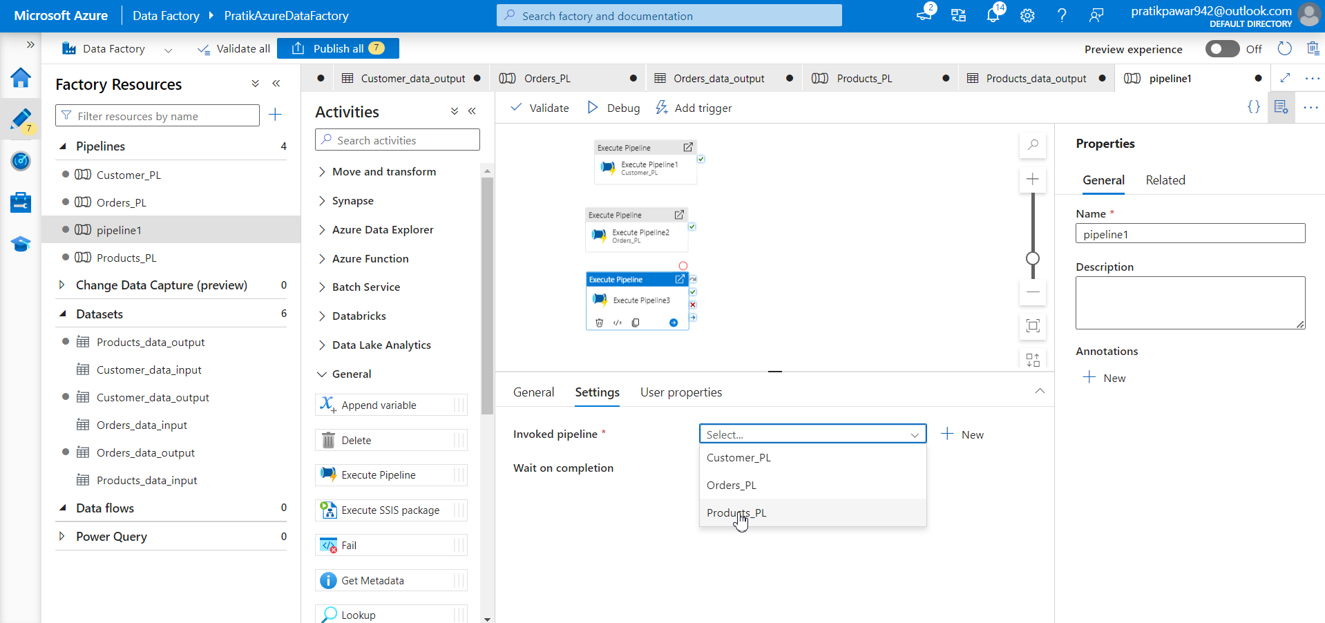
Similarly for the third one

Slide 24
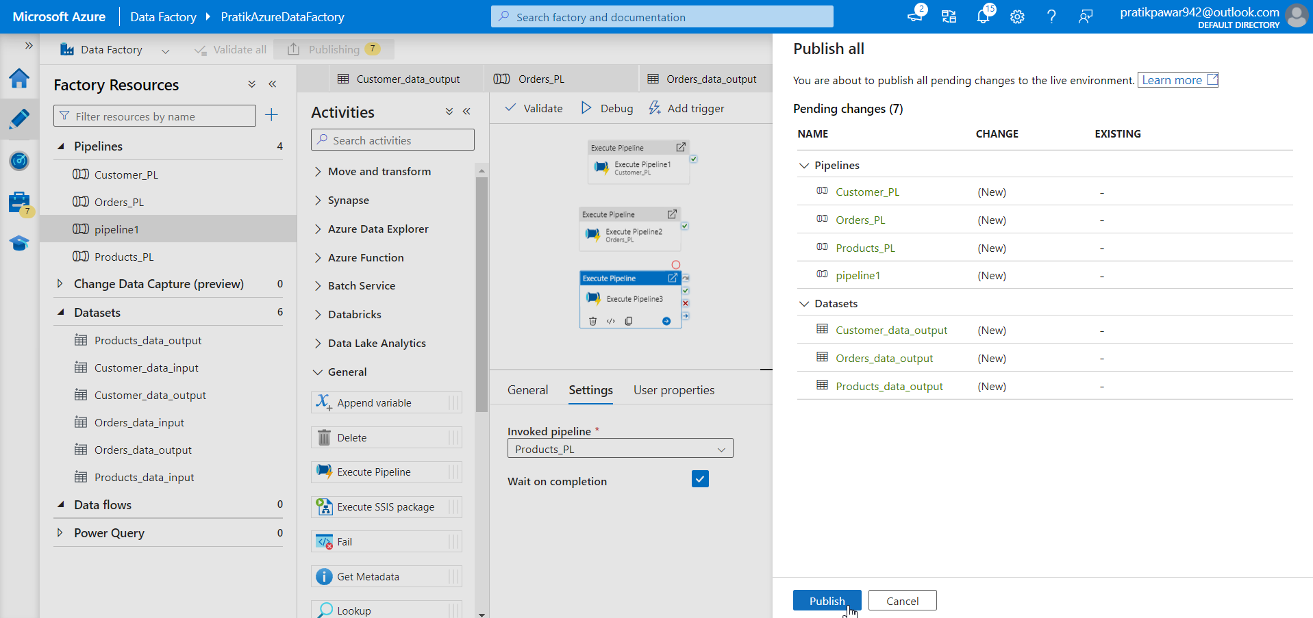
Publish

Slide 25
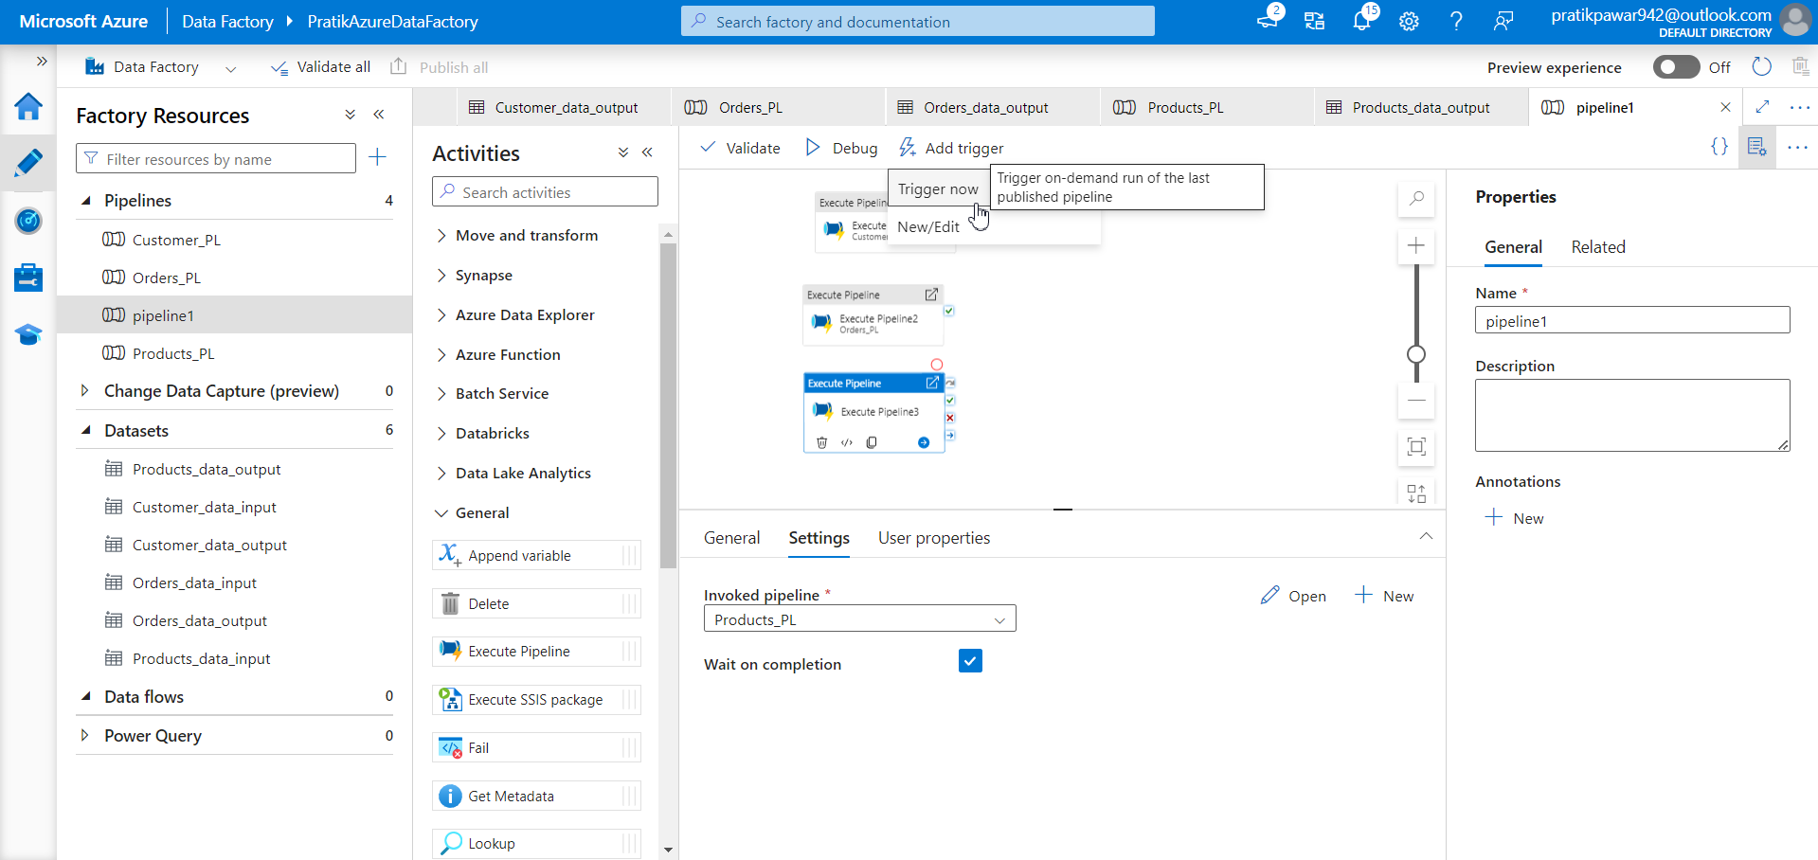
Trigger( this is parallel processing : interview)

Slide 26
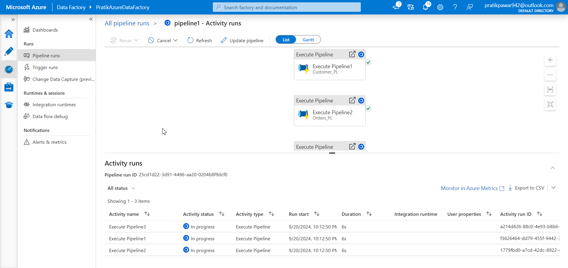
Wait for Migration pipelines to execute

Slide 27
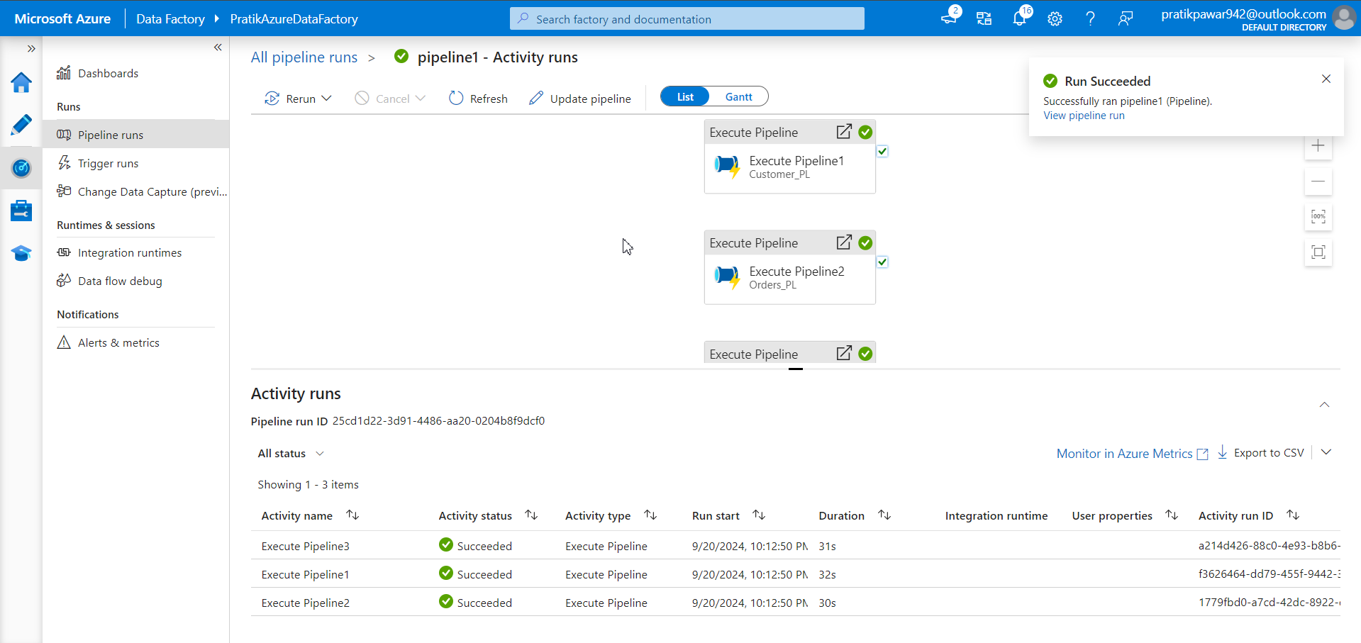
Success and now check data in AzureSQL Database

Slide 28
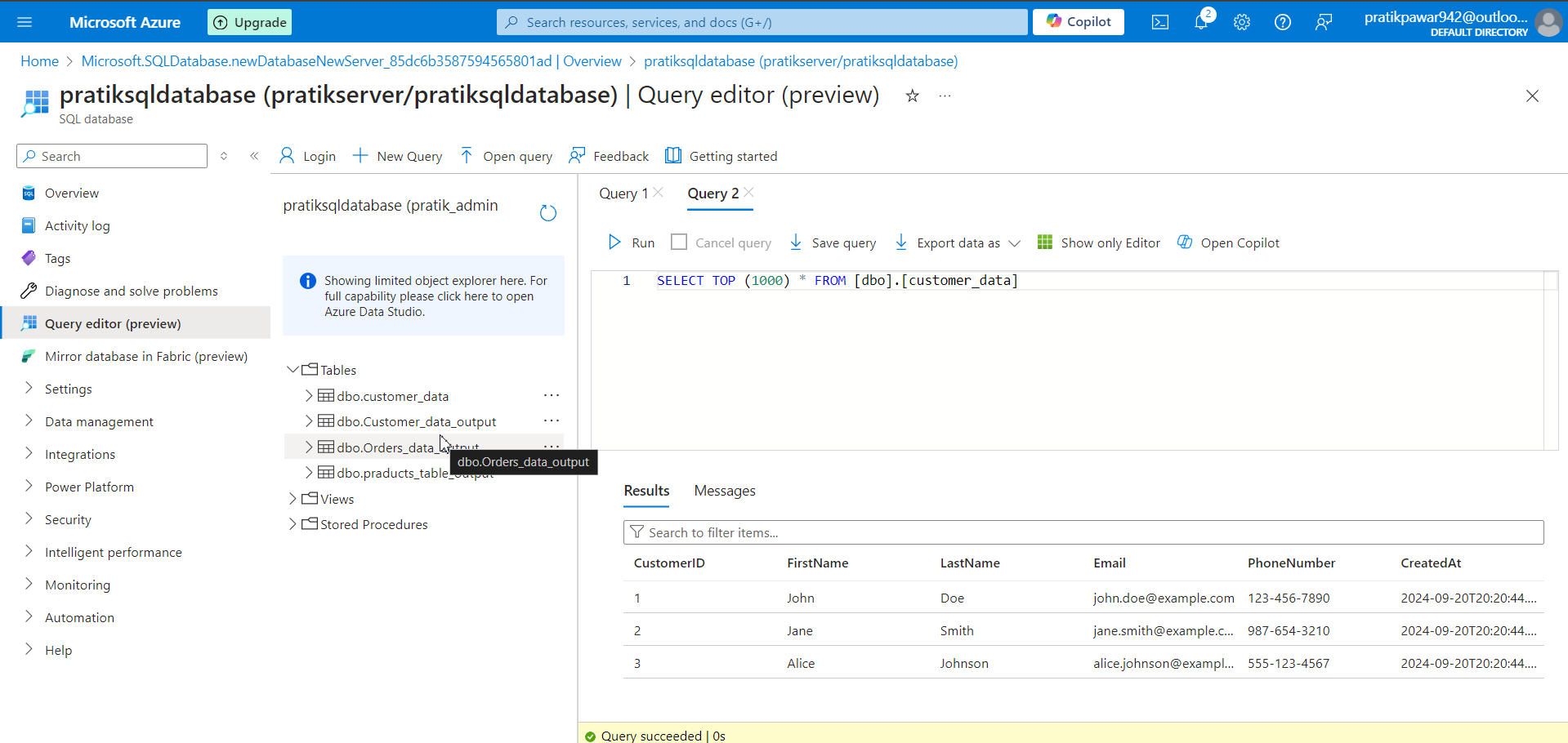
Data has been migrated from onprem to cloud

